Slide 1
The BBC micro:bit and C++
Tom Ball
Microsoft Research
http://research.microsoft.com/microbit/
http://www.touchdevelop.com/
Notes:
I’ll describe the technology stack we created in partnership with ARM and Lancaster University to make it simple for students to get started coding with micro:bit from a web browser, and then uncover the complexity that lies underneath in the micro:bit’s C++ runtime. The Block Editor provides an introduction to structured programming via blocks that can be snapped together. Touch Develop introduces a statically-typed scripting language with syntax-directed editor. Browser-based compilers from the Block Editor to Touch Develop and from Touch Develop to C++ automate the transition from a visual language to a text-based language, and then to C++, the language of the mbed-based micro:bit. For more information: see http://www.touchdevelop.com/microbit/ and http://research.microsoft.com/microbit/

Slide 2
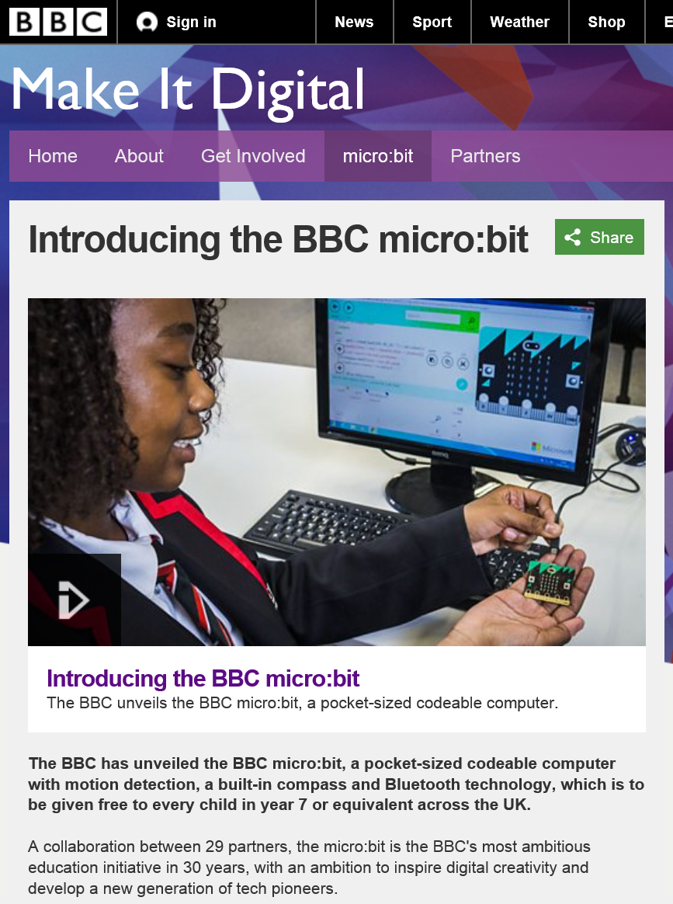
Vision
Repeat the "BBC Micro" impact; from classroom to kitchen table
A year-long campaign across all of BBC broadcasting
A million devices, one for each 12-year old
Microsoft a leading partner; Touch Develop the platform

Slide 3
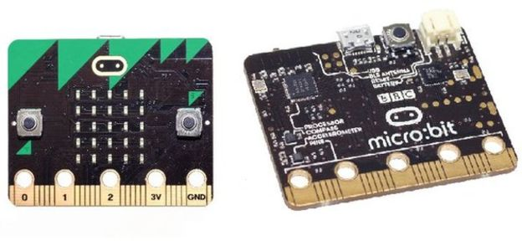
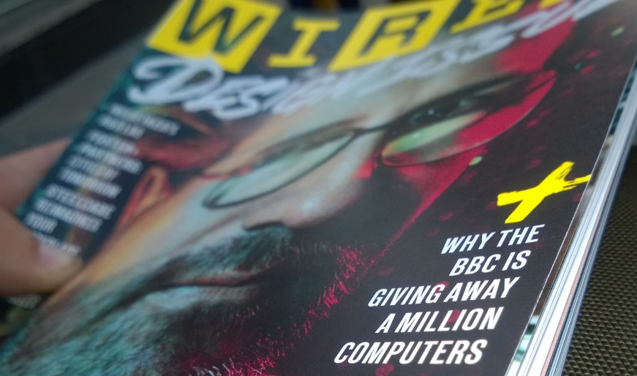
What is the BBC micro:bit?
a small personal coding device
an exciting intro to coding and making for students, with features to span multiple years
BBC providing 1 million to year 7 students in the UK, with massive radio, TV, online campaign
Notes:
The BBC micro:bit is a small wearable and programmable mbed-based device that visibly features a 5x5 LED display, accelerometer, compass, buttons, I/O pins, Micro USB plug, Bluetooth Low Energy antenna, ARM Cortex-M0 processor, and battery plug. Just like Arduino, the micro:bit can be connected to and interact with sensors, displays, and other devices. The first wave of micro:bits will land in UK schools this autumn, with every Year 7 student in the UK receiving a micro:bit, for free.

Slide 4
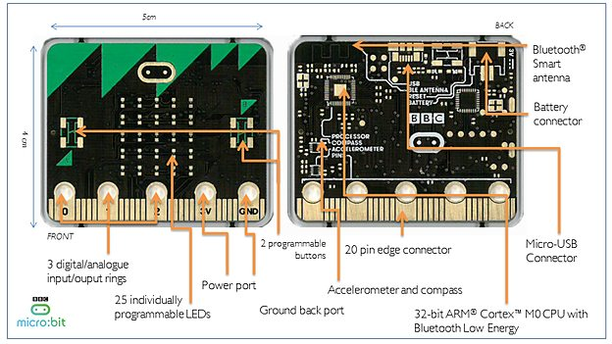
Notes:
25 red LEDs to light up, flash messages, create games and invent digital stories
Two programmable buttons activated when pressed. Use the micro:bit as a games controller. Pause or skip songs on a playlist.
On-board motion detector or 'accelerometer' that can detect movement and tell other devices you’re on the go. Featured actions include shake, tilt and freefall. Turn the micro:bit into a spirit level. Light it up when something is moved. Use it for motion-activated games.
A built-in compass or 'magnetometer' to sense which direction you’re facing, your movement in degrees, and where you are. Includes an in-built magnet, and can sense certain types of metal.
Bluetooth Smart Technology to connect to the internet and interact with the world around you. Connect the micro:bit to other micro:bits, devices, kits, phones, tablets, cameras and everyday objects all around. Share creations or join forces to create multi-micro:bit masterpieces. Take a selfie. Pause a DVD or control your playlist.
Five Input and Output (I/O) rings to connect the micro:bit to devices or sensors using crocodile clips or 4mm banana plugs. Use the micro:bit to send commands to and from the rings, to power devices like robots and motors.

Slide 5
Goals
a browser-based introductory programming experience for students who have never programmed before
an architecture that allows students to dig deeper to uncover the capabilities of the micro:bit
materials and a platform to support teachers with the micro:bit in their classrooms

Slide 6
Demo (www.microbit.co.uk)

Slide 7

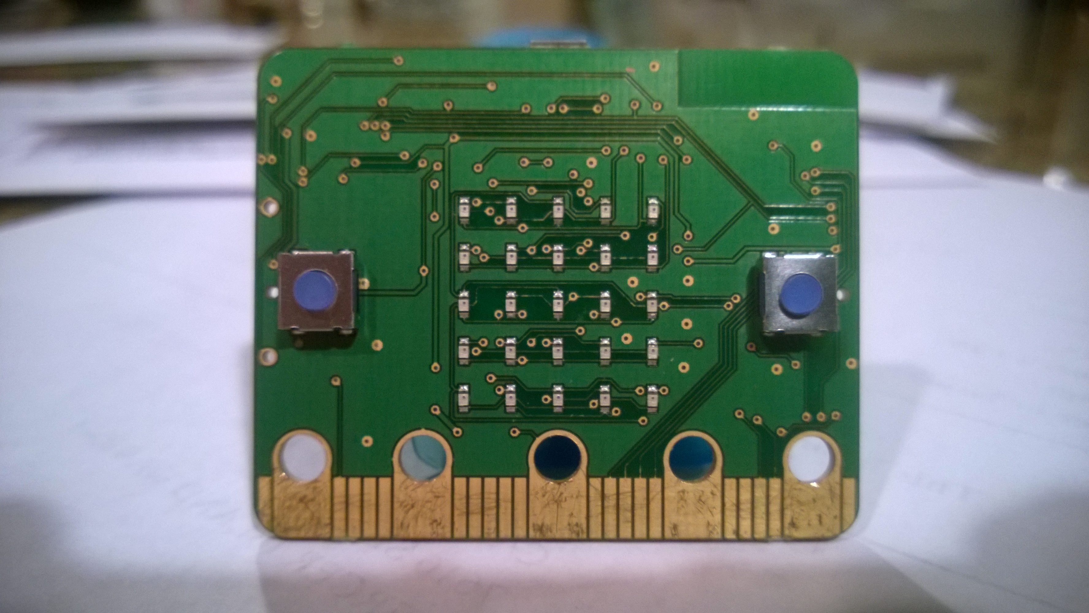
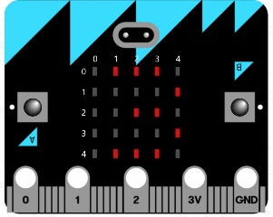
Client Computer
Web browser
TouchDevelop script
USB
1
Drive
User codes TouchDevelop
script and presses “compile” button
Compiler
1
TouchDevelop
C++
C++ program
ARM binary
3
User copies ARM binary
to micro:bit drive
Compiler
2
C++
mbed C++ SDK
ARM
2
User accepts download
of ARM binary
mbed compile service
ARM binary program
Notes:
After programming a TouchDevelop script in the browser, the user can request compilation to an ARM binary. The TouchDevelop to C++. The second compilation happens in the cloud, where the generated C++ is compiled and linked with the C++ runtime, producing an ARM binary sent back to the user.

Slide 8
Some “interesting” constraints
ARM Cortex M0
128K Flash (for program and static data)
16k RAM (for stack and heap)
Bluetooth Low Energy (BLE) stack
Eats up quite a bit of RAM (~12k)
Support both flashing with USB and “over the air” with BLE

Slide 9



The technology stack
www.touchdevelop.com
browser-based edit/run/simulate
compile to C++
C++ micro:bit runtime
mbed platform, C++ compiler service
Notes:
A main challenge we faced in this project was to make it simple for any student, regardless of experience, to successfully program the micro:bit. We addressed this challenge through a technical partnership with Lancaster University and ARM. Together, we provide a path from the browser-based TouchDevelop scripting environment down to safe and efficient C++, the supported language of ARM’s mbed platform.

Slide 10
ARM’s mbed platform
mbed-compatible board appears as Mass Storage Device when connected via USB
Copy hex file to MSD to flash it (Windows, Linux, MacOs)
http://developer.mbed.org/
Free, web-based development environment
Compile C++ to hex file using armcc or gcc (ARM cloud service)
mbed SDK is open source under Apache 2.0
https://developer.mbed.org/users/mbed_official/code/mbed-src/
https://developer.mbed.org/handbook/mbed-library-internals

Slide 11
micro:bit C++ runtime
Provides a DAL for future-proofing micro:bit
hardware components
simple message bus and events
co-routines (fibers) and non-preemptive scheduler
high-level helper functions (scroll string)
a few managed types (reference counted)
To be open sourced (currently private) at
https://github.com/lancaster-university/microbit-dal

Slide 12
Control and Coordination
MicroBitButton
represents a single, generic button
MicroBitMultiButton
represents a virtual button, capable of reacting to simultaneous presses of multiple other buttons
MicroBitCompass
represents an implementation of the Freescale MAG3110 I2C Magnetometer (includes basic caching, calibration and on demand activation)
MicroBitDisplay
represents the LED matrix array of the device
MicroBit
represents the micro:bit device as a whole and its various components
MicroBitComponent
abstract representation of a hardware component
the functions needed to drive/poll that hardware
MicroBitEvent
an event generated by some MicroBitComponent
MicroBitMessageBus
delivers asynchronous MicroBitEvents via a send/listen pattern
Fiber
a lightweight representation of a cooperative thread of execution (i.e., a co-routine)

Slide 13
More Classes
MicroBitSerial
a subclass of mbed’s Serial that accepts micro:bit specific data types
MicroBitIO
a representation of all given I/O pins on the edge connector
MicroBitI2C
indirect access to mbed I2C
MicroBitEventService
provides a BLE gateway for sending MicroBitEvents to the MicroBitMessageBus
MicroBitDFUService represents a Device Firmware Update (DFU) loader that
provides a simple mechanism to identify an individual micro:bit amongst a classroom of others
allows BLE devices to discover and cache a passcode that can be used to flash the device over BLE
provides a BLE escape route for programs that 'brick' the micro:bit

Slide 14
Touch Develop is…
1
2
a social cloud of scripts, users, forums | a browser-based IDE, for mobile devices
a statically-typed language and libraries | Automated tutorials for absolute beginners
programming progression | www.github.com/Microsoft/TouchDevelop
3
4
5
6

Slide 15
From TouchDevelop to C++
Compilation generates free-standing references:
to functions to be filled in by the glue layer (e.g. number::lt(x, y))
to types defined by a given library
micro_bit::user_types::Image
in this case, TD Image is marked as "shim" and glue layer defines Image
to built-in types (Number, Boolean, String)
typedef'd to their actual implementation
to parameterized types (e.g. Collection<T>)
defined using C++-11 to ManagedType<vector<T>>
Glue layer (to be open sourced)
https://github.com/Microsoft/
Notes:
Safety: every field access is written using a ternary operator and the C "comma" expression to first check that the object is valid before dereferencing one of its fields (or panic otherwise). No segfaults for user programs! Let's break down how this is done.
l->next
is compiled as
(l.get() != NULL ? l->next : (uBit.panic(...), l->next))
* l.get() gets the pointer behind the ref-counted wrapper class
* -> is overloaded for ref-counted classes
* uBit.panic() never returns, but the C++ compiler is not aware of that, and returns a type error, unless the two branches of the ternary operator ? return the same type
* therefore, the comma operator works just fine in that setting
Memory allocation: ref-counting. We probably could've used std::shared_ptr, but our custom allocation is simpler and more lightweight (because it's not thread-safe, since we're cooperative).
I think that's pretty much it. Let me know if you need more information.
~ jonathan

Slide 16
TouchDevelop entities to C++
User-defined libraries and types
every library is wrapped into a namespace
each function from the library gets assigned a human-readable name and is defined inside that namespace
user-defined types are within another (nested) namespace called user_types
Recursion
because everything can be mutually recursive, we declare first type "stubs”, then function stubs, then the actual functions
Notes:
namespace user_types {
struct list_;
typedef ManagedType<list_> list;
}
- then, we can fully declare types while referring to previously-defined type "stubs", allowing arbitrary recursion across types
namespace user_types {
struct list_ {
Number elt;
user_types::list next;
};
}
- please note that this is done whole-program: we write the type stubs of *all the types across the program and all its libraries*, then the type definitions of *all the types...*, etc.
then, we declare function stubs (because functions may be mutually recursive)
Number length(user_types::list l);
then we define actual functions
Number length(user_types::list l) {
Number r5;
return number::plus(1, length((l.operator->() != NULL ? l->next : (uBit.panic(MICROBIT_INVALID_VALUE), l->next))));
return r5;
}
Among these functions is one called "main". We wrap everything in a touch_develop namespace (so as not to pollute the global namespace), then we define the app_main symbol that the run-time system needs.
void app_main() {
touch_develop::main();
}

Slide 17
Capturing state: C++11 to the rescue!
C++11 closures alleviate the need for
closure conversion
lambda lifting
Example
http://test.microbit.co.uk/ddgrla
Uses std::function to copy the stack-allocated closure into the heap so that event handlers can call it whenever the event is generated.
Notes:
Closures: C++11 to the rescue! See my script "ref vs copy" (ddgrla). You can say that piggybacking on C++11 closures allows us to *not* do closure-conversion and lambda lifting. Furthermore, we use std::function (see generated code for that script) to copy the stack-allocated closure into the heap so that event handlers can call it whenever the event is generated.

Slide 18
Questions?

